Slide 1

Functions
TUIT
C++ Programming, Fall 2016
Lab #6
(I - part)

Slide 2
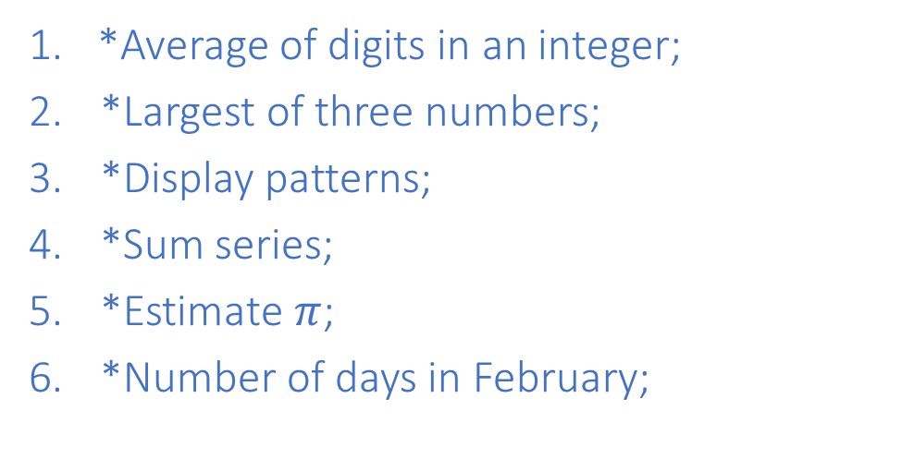
Read the lecture notes doing following tasks:
TUIT
Practice (I - part)
*Average of digits in an integer;
*Largest of three numbers;
*Display patterns;
*Sum series;
*Estimate $π$;
*Number of days in February;
*Geometry: Point position;
*Even Palindrome number;
**Game: craps;
**Emirp;
**Math: approximate the square root;
*Even or Odd digit integer;

Slide 3


TUIT
1. *Average of digits in an integer
Write a function that computes the average of the digits in an integer. Use the following function header:
double averageDigits(long n)
For example, averageDigits(936) returns 6.0 ((9 + 3 + 6) / 3). (Hint: Use the % operator to extract digits, and the / operator to remove the extracted digit. For instance, to extract 6 from 936, use 936 % 10 = 6. to remove 6 from 936, use 936 / 10 = 93. Use a loop to repeatedly extract and remove the digit until all the digits are extracted.) Write a test program that prompts the user to enter an integer and displays the sum of all its digits.
Here is a sample runs:
Enter an integer: 936 Average of digits in an integer 6.0

Slide 4
TUIT
2. *Largest of three numbers
Write a function with the following header to display the largest of three numbers:
void displaylargest(
double num1, double num2, double num3)
Write a test program that prompts the user to enter three numbers and invokes the function to display the largest of them.
Here is the sample run:
Enter three numbers: 5 2 4 The largest of three numbers is 5

Slide 5
TUIT
3. *Display patterns
Write a function to display a pattern as follows:
****************
***************
**************
…
*
The function header is void displayPattern(int n)
Here is the sample run:
Enter an integer for pattern: 3 *** ** *

Slide 6
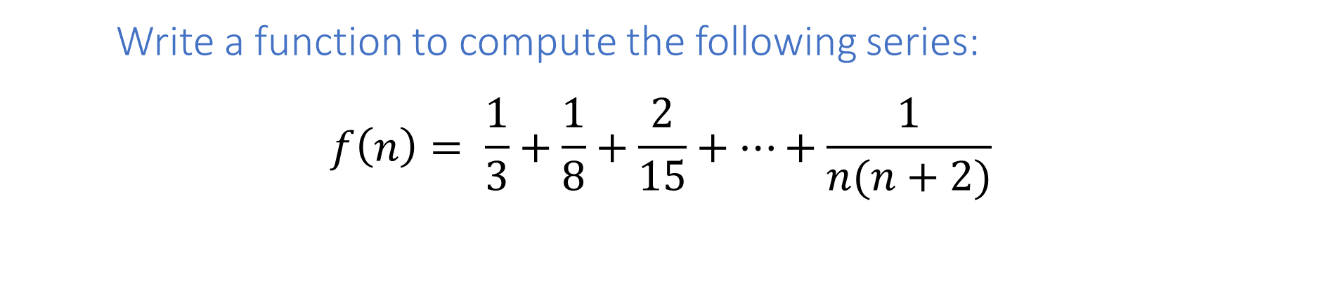
TUIT
4. *Sum series
Write a function to compute the following series:
$$f\left(n\right)= \frac{1}{3}+\frac{1}{8}+\frac{2}{15}+…+\frac{1}{n(n+2)}$$
Here is the sample run:
Enter an integer: 4 Result of f(4) is 0.566667

Slide 7
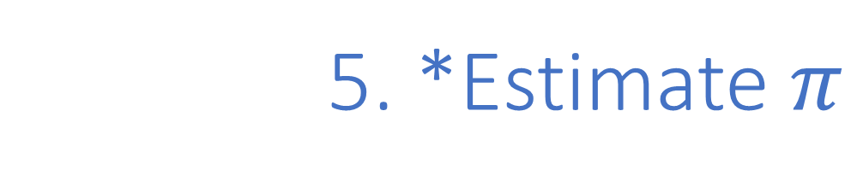
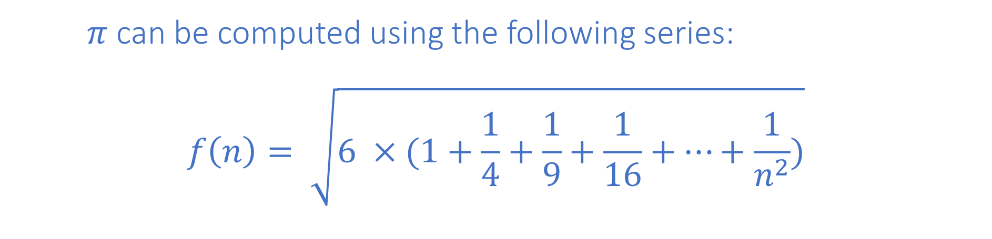
TUIT
5. *Estimate $π$
$π$ can be computed using the following series:
$$f\left(n\right)= \sqrt{6 ×(1+\frac{1}{4}+\frac{1}{9}+\frac{1}{16}+…+\frac{1}{n^{2}})}$$
Here is the sample run:
Enter an integer: 20 Result of f(4) is 3.09467

Slide 8
TUIT
6. *Number of days in February
Write a function that returns the number of days in February using the following header:
int numberOfDaysInFebruary(int year)
Here is the sample run:
Enter the year: 2001 28 days in February, 2001

Slide 9
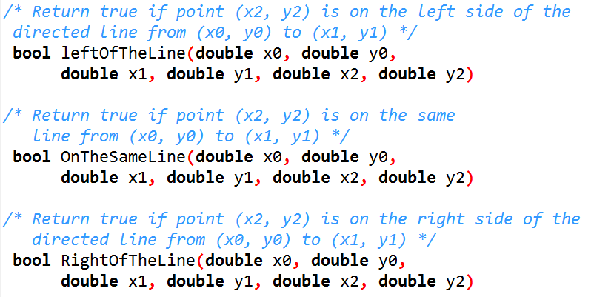
TUIT
7. *Geometry: Point position;
Write the following functions:
Here are some sample runs:
Enter three points for p0, p1, and p2: 1 1 2 2 1.5 1 (1.5, 1.5) is on the right side of the line from (1.0, 1.0) to (2.0, 2.0)
Enter three points for p0, p1, and p2: 1 1 2 2 3 3 (3.0, 3.0) is on the same line from (1.0, 1.0) to (2.0, 2.0)
Enter three points for p0, p1, and p2: 1 1 2 2 1 1.5 (1.0, 1.5) is on the left side of the line from (1.0, 1.0) to (2.0, 2.0)

Slide 10
TUIT
8. **Even Palindrome number
A number is a palindrome if tis reversal is the same as itself. An even palindrome number is a number which is even and also a palindrome. Write a program that displays the first 50 even palindrome numbers. Display 5 numbers per line and align the numbers properly, as follows:
Here is a sample run:
2 4 6 8 22 44 66 88 202 212 …

Slide 11
TUIT
9. **Game: craps
Craps is a popular dice game played in casinos. Write a program to play a variation of the game, as follows:
Roll two dice. Each die has faces representing values 1, 2, …, and 6, respectively. Check the sum of the two dice. If the sum is 2, 3, or 12 (called craps), you lose; if the sum is 7 or 11 (called natural), you win; if the sum is another value (i.e., 4, 5, 6, 8, 9, or 10), a point is established. Continue until roll either a 7 (you lose) or the same point value (you win). Your program acts as a single player.
Here are some sample runs:
You rolled 5 + 6 = 11. You win
You rolled 1 + 2 = 3. You lose
You rolled 4 + 4 = 8. Point is 8 You rolled 6 + 2 = 8. You win
You rolled 3 + 2 = 5. Point is 5 You rolled 2 + 5 = 7. You lose

Slide 12
TUIT
10. **Emirp
An emirp (prime spalled backward) is a nonpalindromic prime number whose reversal is also a prime. For example, 17 is a prime and 71 is a prime. So 17 and 71 are emirps. Write a program that displays the first 100 emirps. Display 10 numbers per line and align the numbers properly, as follows:
13 17 31 37 71 73 79 97 107 113 149 157 167 179 199 311 337 347 359 389 …

Slide 13

TUIT
11. **Math: approximate the square root
How is the sqrt function in the cmath library implemented? There are several techniques for implementing it. One such technique is known as the Babylonian method. It approximates the square root of a number, n by repeatedly performing a calculation using the following formula:
$nextGuess=\left(lastGuess +\frac{n}{lastGuess}\right)$ / 2.

Slide 14
TUIT
11. **Math: approximate the square root
When nextGuess and lastGuess are almost identical, nextGuess is the approximated square root. The initial guess can be any positive value (e.g., 1). This value will be the starting value for lastGuess. If the difference between nextGuess and lastGuess is less than a very small number, such as 0.0001, you can claim that nextGuess is the approximated square root of n. If not, nextGuess becomes lastGuess and the approximation process continues. Implement the following function that returns the square root of n:
double sqrt(int n)
Here is the sample run:
Enter an integer: 8 The square root is 2.82843

Slide 15
TUIT
12. *Even or Odd digit integer
Write a function that checks whether an integer is an even digit or an odd digit integer using the following header:
int getType(int n)
For example, getType(39) is an even digit integer and getType(5) is an odd digit integer. Write a test program that prompts the user to enter an integer and displays its type.
Here are some sample runs:
Enter an integer: 39 36 is an even digit integer
Enter an integer: 8 36 is an odd digit integer

